Slide 1
Collaboration Platform

Slide 2
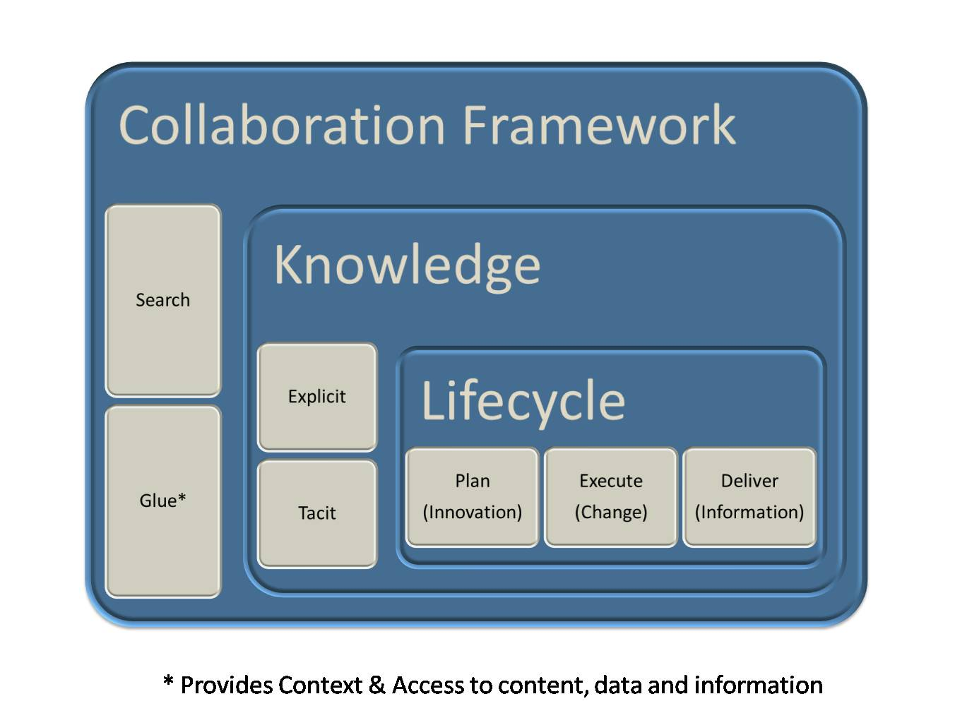
Blueprint

Slide 3
Blueprint Overview
Layer (Lifecycle)
  There are 4 core areas of collaboration that we need to address to support the Innovation Pipeline:
    Ideation Phase 1 scope
    Transition Phase 2 scope
    Execution Phase 2 scope
    Information Phase 3 scope
Layer (Knowledge) *
  Involves capturing knowledge throughout the entire innovation pipeline. There are 2 types of knowledge that we need to capture, warehouse and effectively share:
    Explicit – documents, content, publications, data
    Implicit – inferred knowledge, experience, insights, know-how
Layer (Framework) *
  Provide the glue that binds collaboration & knowledge together so it can be fully leveraged w/in & w/o the innovation pipeline.
  * These layers will be built out in a progressive manner across all 3 phases

Slide 4

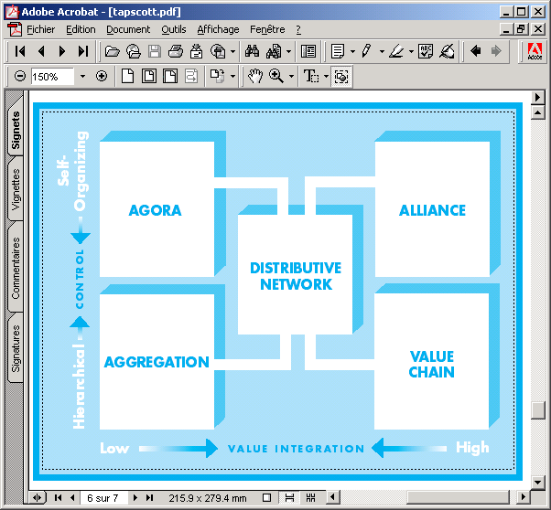
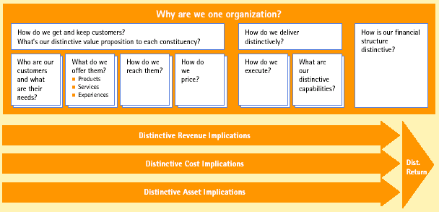
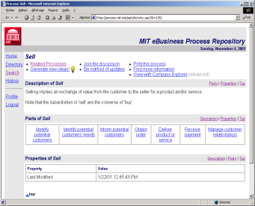

State of the Art (I) – e-business models
Categorization
  According different axes (innovation, integration, control …)
  Timmers, Rappa, Tapscott …
Modeling
  Concepts and questions
  Hamel, Afuah, Linder
  Weill, Rayport, …
Tools
  Computer-aided design
  MIT Process Handbook (Malone)

Slide 5




State of the Art (II) - ontology
The Enterprise Ontology
  collection of terms and definitions relevant to business enterprises
  Activities and processes, organization, strategy, marketing, time
On-to-knowledge (XML)
Content-driven Knowledge-Management
through Evolving Ontologies
Electronic Business (EDI) using XML
  «To provide an open XML-based infrastructure enabling the global use of electronic business information in an interoperable, secure and consistent manner by all parties»
  Other EDI ontology: bizTalk, cXML, CBL
Scénario

Slide 6
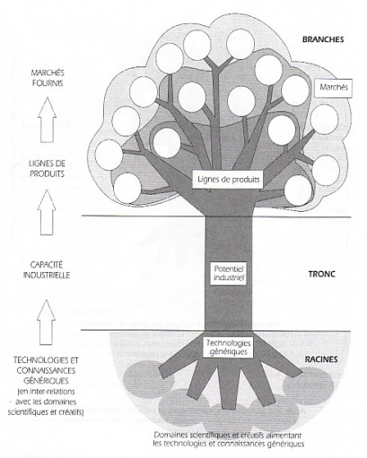
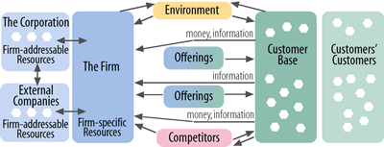
State of the Art (III) – business strategy
(Un-)bundling the corporation
  Product (What?), Customers (Who?), infrastructure (How?)
  Hagel, Markides …
Competence tree
  Knowledge, strategy, value creation
  Giget, …
Value creation framework
  value-creating activities result in
  offerings provided to customers
  Ramirez, Wallin, Norman …
WHO
WHAT
HOW
Market
Product
Activities
Capabilities

Slide 7





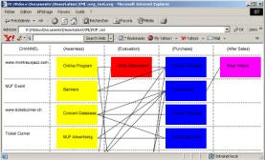
Generating documents from a BM²L document
HTML
Document
e.g. a two page overview of a company’s business model
XSL
Processor
BM²L
Document
PDF
Document
e.g. a ten page report of a company’s business model
Word
Document
e.g. a detailed n-page description of the company’s business model
BM2L
Schema
XSL Stylesheet
Document
SVG
Document
e.g. a graphical view of a business model issue such as the channel strategy

Slide 8
Evaluating the Business Model Ontology
Compare ontology with literature
Positioning the ontology to the existing business model literature shows which domains are covered or not and is an indicator of completeness.
Evaluate ontology by practitioners
Interviewing managers and consultants on the ontology gives an indication on its ability to describe the business logic of a firm.
Test ontology with case studies
Describing a real world business model through the ontology's rigorous formalism tests its applicability to case studies.
Evaluation
Interest by the research community
Observing the research community's interest in the ontology demonstrates certain aspects of its validity.
Test ontology in the field
Testing the ontology in the field would take place indirectly through applying an instantiation of it to a real-world business setting.
Test ontology vs. other model in the field
Testing two models' performance would also be indirect by applying them to a real-world business setting and compare the outcome.

Slide 9
A framework for assessing a technology environment
Research with
Giovanni Camponovo, phd
uncertain
Environment
complex
disruptive
ISSUE
Ontology
Multi-perspective
MODEL
ACTOR
USE
Structural analysis
Actor-issue analysis
Analysis & visualization
TOOL
Analysis
Five forces analysis
Policy network analysis
Disruption analysis
Adoption analysis

for assessing environment (present)
and designing scenarios (future)

Slide 10
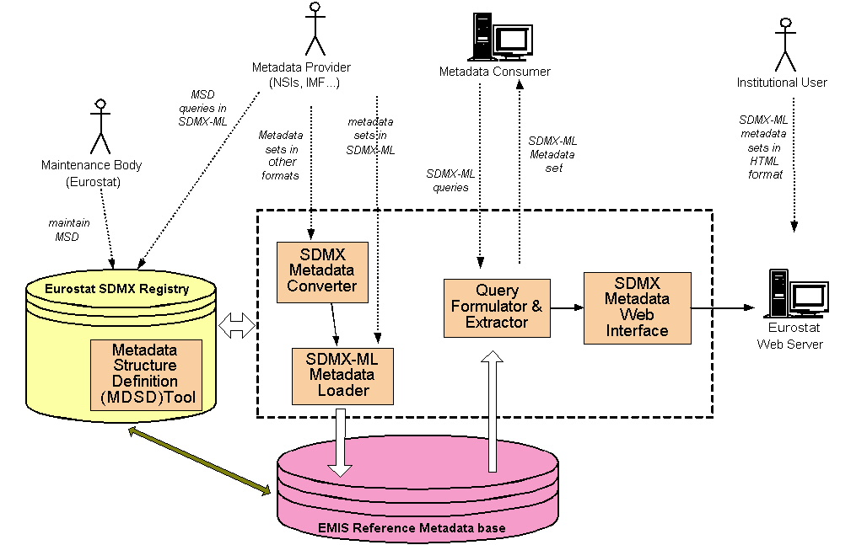
SDMX reference metadata architecture

Slide 11
What’s the future state look like ?
Emails, documents, meetings and other work products that a knowledge worker touches in the context of a business topic are tightly related to each other and always available alongside any of the other
There is no need to figure out where to put a document, or an email, or a meeting note or even data – it will automatically be captured in relation to the context(s) in which they exist.
Records management, compliance, and security does not require additional effort
Business users may be associated with hundreds of contexts (or business topics and projects) but they will automatically have documents, emails and other content related to those contexts that are relevant to them at any time, when they are disconnected. Changes are synchronized and
All business information available on their laptop when off-line is encrypted and cannot be accessible to an unauthorized user.
Find people and content by looking up the context. Find people by the expertise needed for a context (or project). Find the content and their context using search – even emails written by others and documents that are work in process – if the user is authorized.

Slide 12
What’s the future state look like ?
People who share the context will share the information without having to email them around
Work products flow among contexts as people write emails – thereby reflecting the actual flow of knowledge
Business processes create standard structured contexts to represent the entities that are being processed
Rules for workflow automation can be applied at the context –
  To gather data, notify people, move content, restrict distribution or access
They focus on their business context – and everything they need for working on them is available
When they complete a document, or send an email – they are automatically captured in the business context.

Slide 13
Benefits of Reference Model
High level reference model enables:
  Open architectures – swapping in and swapping out components over time without loss of investment
  Appropriate functional growth at the component level
  Extensibility of content coverage
  Scalability of the architecture in terms of volume of content and level of use
  Emergence of an enterprise level thinking about how to manage content
  Enterprise level thinking about stewardship and governance of information

Slide 14
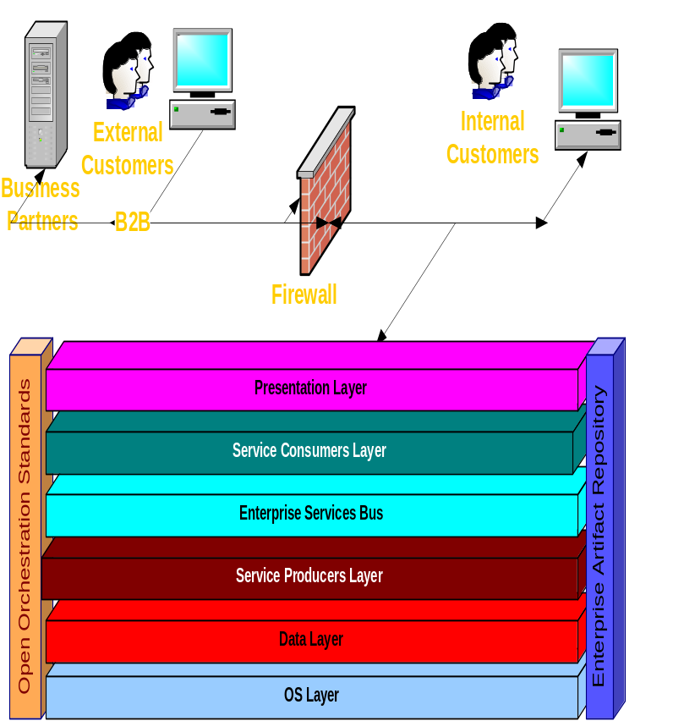
Architecture Layers
Agenda:
  The Presentation Layer responsible for all requests and replies to and from the enterprise;
  The Service Requestors (BP) Layer responsible for request/reply exchanges with ESB
  he Enterprise Service Bus Layer representing a common informational environment supporting uncoupled, guaranteed, standard-based information exchange between service requestors and producers;
  The Service Producers Layer – the former System Domain, comprised of business-related service clusters, exchanging messages with other ESOA participants through ESB.
  The Data Service Layer – the part of the Data Layer usually responsible for providing a Single View of Truth – the unified view of the Enterprise’s dispersed data;
  The Data Storage Layer represents the dispersed Enterprise Data Storages, including public and internal RDBMS, Data Warehouses, tapes, files, etc.
B-Wave Software ®. All Rights Reserved ©

Slide 15
The ESOAF is a Reference framework that is built completely on the meta-artifact level in order to be applicable to any IT-based Enterprise;
Main characteristics of ESOAF:
  A gradual, incremental approach to the Enterprise Architecture Transformation from an application-centric Initial State – Legacy Enterprise to a completely ESOA based Desired State – Elegant One;
  Completely uncoupled through ESB service requestors and service providers;
  Maximizes component reuse, and minimizes the problems associated with component enhancement & replacement;
  Facilitates exit from current & future legacy systems;
  Closes the Business-IT gap by implementing Business Process Flows;
  Analysis, Design, and Technology Agnostic;
  Encourages and facilitates creation and reuse of the Enterprise Reusable Artifacts;
  The expectation of ROI is ~30% in one year;

Slide 16



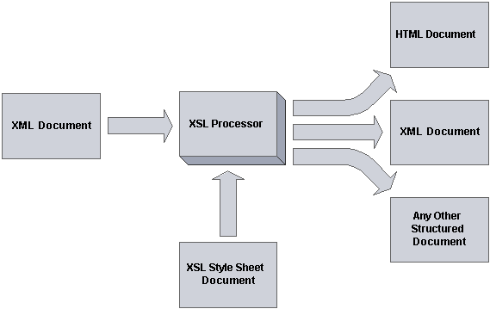
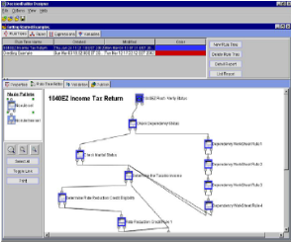












Actors
Channels
Elegant Enterprise IT Architecture Framework
Reusable
Artifacts
Repository
Intellectual Property Domains
VXML/ HTTPS
Business Processes
Business Rules
End user
XML/ HTTPS
Business Process Subflows
IVR
Agent
XML Gateway
Web
Business Rules
ESB
Manager / Admin
Client / Server
Business Services
Business Services Domains
Data Services Domains
B2B Partner
B2B gateway
BI, ETL
ETL
Enterprise Data Signatures
ERP
CRM
Batch
Data Warehouse
Main DB
Public DB

Slide 17
Goals
Facilitate integration and repurposing of content
- Provide broad search and retrieval capabilities
- Increase reuse and decrease redundancy across content providers
Increase the value and quality of content
- Build intelligent relationships among disparate content sources using concepts and metadata
- Define, enforce, monitor processes/procedures on content collections to ensure quality
Simplify and complete the content life-cycle
- Reduce the number of user-facing content entry points by using already existent business processes
- Manage content end-to-end from initial inception to final disposition
Consistent information security and disclosure enforcement
- Bank records must be consistent in order to facilitate disclosure policy compliance and information sharing for partners

Slide 18
End game of blueprinting you ECA is a high level reference model
Taxonomies live in every component of your ECA – they become ECA when you integrate them

Slide 19
Blueprint Overview (cont.)
Collaboration Framework
  There are 2 core pieces of infrastructure that we need to purchase and implement
    We need an enterprise search engine that can support explicit searches (using keywords) as well as implicit searches (using inferences and relationships between pieces of information and data) [Semantic Search]
    We also need to implement a way to connect people, knowledge, ideas and information based on their roles in the organization and the contexts associated with the type of artifacts contained in the collaboration framework. We call this the “glue”. It should be extendible to new and existing content and be mostly invisible to the end users.
  One additional challenge will be providing users with a way to filter and direct all this content so it is easy to consume.

Slide 20
Phase 1 - Deliverables
Pilot 2-3 tools/solutions from vendors in Feb
Run the concept by the Solutions Review Committee (governance step 1)
Run the set of tools being evaluated by the ARB (governance step 2)
Create a project in eProject (forms, estimates, ROI, funding sources, etc.)
Define a set of requirements (features, metrics for success, constraints)
Draft an architecture for the social networking framework
Identify the suite of tools that we need for the framework *
Identify training needs for facilitators
Identify one or more teams to be included in a pilot
* Determine which tools should be targeted towards population segments w/in HSP

Slide 21
Phase 1 – Deliverables (cont.)
Draft a communication plan for a corporate rollout
Define a semantic model for the meta data
Identify a search engine to facilitate search on existing content & future content
Document a set of metrics to capture for monitoring activity
Draft a set of reports/processes for monitoring activity
Draft an escalation model for ideas to be “bubbled up”
Draft a process for folks to escalate concerns with ideation inhibitors (***)
Draft a data mining solution for identifying ideas (at various stages of maturity) **
** Ideation Lifecycle (Idea -> Vetted Idea -> Concept - > Entered into Accolade Front End - > POC - > Project)
*** People, Culture, Processes

Slide 22
Types of Content
Documents
Data
Publications
Communications
People & Communities
Knowledge
Services
Collections

Slide 23
ECArch
Each organization has to make their own decisions here
We have to respect the business system ownership of the content
We leave business system information in tact, map to enterprise content architecture
ECM then means managing functionality using a high level set of metadata across the organization
Means harmonizing attributes and in some cases managing the values for those attributes

Slide 24

Big Picture Enterprise Content Architecture
Site Specific
Searching
Publications
Catalog
World Bank Catalog/
Enterprise Search
Recommender
Engines
Personal
Profiles
Portal Content
Syndication
Browse &
Navigation
Structures
Metadata Repository
Of Bank Standard Metadata
Reference Tables
Topics, Countries
Document Types
Transformation
Rules
Data
Governance
Bodies
Metadata
Extract
Metadata
Extract
Metadata
Extract
Metadata
Extract
Metadata
Extract
Metadata
Extract
IRIS
Doc Mgmt
System
Board
Documents
Metadata
Web
Content
Mgmt.
Metadata
IRAMS
Metadata
JOLIS
Metadata
InfoShop
Metadata
Concept Extraction, Categorization & Summarization Technologies

Slide 25
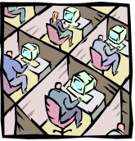


Content
Contributor
End User
DELIVERY
Content Systems
Metadata Management and Security Services
ePublish
PDS
….
access
rules
Content Access Services
Content Management Services
view
multilingual srch
workflow
create/del.
check in/out
retention
schedule
search
syndication
versioning
declare
classification
browsing
notification
Business
Activity
Topic Class Scheme
Content Integration and Archives Services
thesaurus
relate
Connector
Concept extraction
rules evaluator
harmonize
Adapter
Series Names
monitors
Archives
Store
Over
Time
Documents,
Images, Audio,
Data records
Metadata
warehouse
SAP
(R/3, BW)
Notes /
Domino
logs
People
Soft
iLAP
Repositories Services
Business Systems

Slide 26
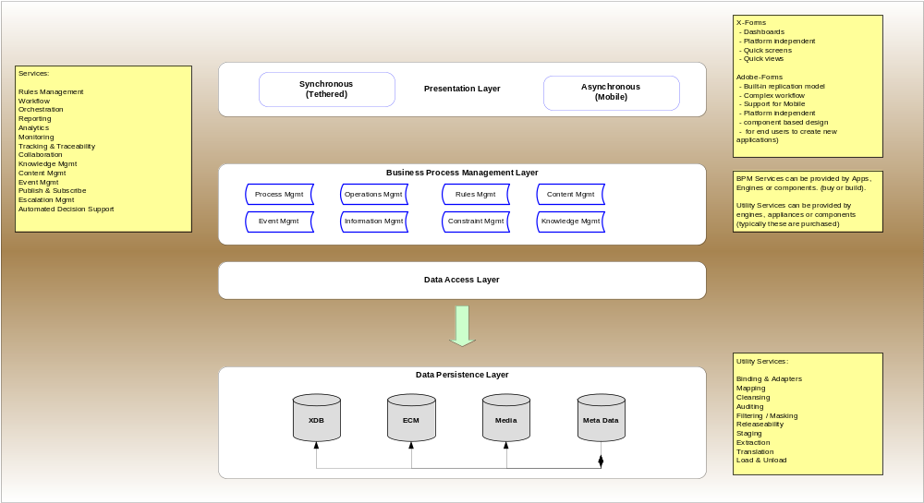
Conceptual Architecture

Slide 27
Basic Functional Components for Goals
Content Integration Services
  Metadata harvest, rationalization and harmonization
  Access to metadata entries, content maps and content
Repository Services
  Defined storage strategy for content over time
  High performance, accessible and scalable metadata and content stores
Content Access Services
  Enterprise-wide search and retrieval
  Access control for all bank records
  Syndication of content to partners institutions – e.g. GDG

Slide 28
Basic Functional Components for Goals
Content Management Services
  Content management function oriented services – versioning, check-in/check-out, collaboration, work flow
Metadata Management and Security services
  Services managing reference data, data dictionaries, taxonomies, thesaurus, business rules (access, security, disposition) which cut across all services

Slide 29
Enterprise Thinking
In the future, we hope to achieve enterprise wide use of full range of reference tables
Some will be ‘closed loop’ stewardship models
Some will be ‘bi-directional’ stewardship models
Idea is that different groups thoughout the enterprise will become stewards of different reference sources
Governance models and taxonomy structures need to be suited to their purpose – not just one kind of taxonomy or one way to govern

Slide 30
Content Architectures
Content types can evolve into content architecture specifications
Content architecture specifications can evolve into input templates – in future building from content element level
You cannot repurpose and decompose working from BLOBs
To manage content type creep, define libraries of content elements within the Top Level types
Grow content templates at the element level but within content type element libraries
Example of doing top down and bottom up development work

Slide 31
Designing for Use
Metadata provides the lowest level of the blueprint for how our content will be used
In an ECA, assumption is that use is enabled across systems
Need to have a core set of metadata that are available across systems to support the ECA
If you have enterprise content types then you are in a better position to see what that core set is
Traditionally, metadata focuses heavily on content features and pays less attention to how it will be used

Slide 32
World Bank Metadata Requirements
Standard metadata schemes are primarily encoding schemes – don’t just accept someone else’s encoding scheme
You should begin by understanding purpose of metadata attributes in a schema
We have used Use Case modeling as a technique to:
  help us understand how content will be used
  kinds of access points we need
  how each access point will behave
  what kind of an underlying taxonomy supports it
Knowledge & Learning Environment

Slide 33
Metadata Basics
Assume you will not change the current business systems
Challenge here is to manage complexity, maintain source systems, respect content security & still meet users expectations
Support integrated use by creating a warehouse of metadata pertinent to access, search, syndication, use management, records compliance and learning
Define metadata attribute super classes to which existing business system metadata are mapped
Attributes may be rationalized, harmonized or value-controlled within super classes
Notes:
13

Slide 34
Taxonomy Examples
Enterprise Topic Classification Scheme – hierarchical taxonomy
World Bank Thesaurus – English, French, Spanish – network taxonomy
Metadata Attribute Detailed Specifications – faceted taxonomy
Content Type Classification Scheme – hierarchical taxonomy
Transformation Rules – faceted taxonomy

Slide 35
The ECA Taxonomy
View
Thesaurus
Language
Topics

Slide 36
Taxonomy Basics
Given this blueprint, let’s step back and examine:
  Where we find taxonomies
  What kind of taxonomies we need
  Where we have what we need already
  Where we should integrate what exists
  Where we need to start from scratch
  When we do start from scratch, how do we begin

Slide 37
Definition of a taxonomy
“System for naming and organizing things into groups that share similar characteristics”
Taxonomy
Architectures
Applications
Notes:
Review of Basic Concepts & Approaches
Essential concepts include:
content
metadata & metadata repositories
navigation architectures
search architectures
portal architectures
Information architectures in portals and web environments are increasingly complex, integrating technologies to deliver value to users. Seamless integration is the goal. Taxonomies are critical data structures that help us to build a sustainable foundation, to integrate efficiently and to manage the complexity. Whole information architecture is more adaptable and sustainable over time if it adheres to established standards and best practices. Whole Information Architecture is more cost effective if new technologies currently being researched or under development can be integrated without re-engineering the base. Like the content and processes they support, each component of a portal has a life cycle.

Slide 38
Taxonomy Architectures
Taxonomy architectures are important to designing taxonomies which:
  are suited to their purpose
  sustainable over time
  provide strong application support to information applications in the new challenging web environment
Taxonomy = architecture + application + usability
Time is too short today to go into the usability issues deeply, but be aware that they are design & implementation issues

Slide 39
Taxonomy Applications
Taxonomies are structures which can be explicitly presented - they can be distinct data structures or interface features
Taxonomies are structures which can be implicitly designed into an application - structures which are embedded or designed into the content or transaction that is being managed

Slide 40
Taxonomy Architectures
There are four types of taxonomy architectures:
  Flat
  Hierarchical
  Network
  Faceted
In my experience, most of the problems we encounter working with ‘taxonomies’ derive from to the fact that we don’t establish the type of taxonomy architecture we need before we begin creating them!

Slide 41
Flat Taxonomy Architecture
Energy Environment Education Economics Transport Trade Labor Agriculture

Slide 42
Flat Taxonomies
Group content into a controlled set of categories
There is no inherent relationship among the categories - they are co-equal groups with labels
The structure is one of ‘membership’ in the taxonomy
  Alphabetical listing of people is a flat taxonomy
  Lists of countries or states
  Lists of currencies
  Controlled vocabularies
  List of security classification values

Slide 43
Facet Taxonomy Architecture
Faceted taxonomy architecture looks like a star. Each node in the star structure is associated with the object in the center.

Slide 44
Facet Taxonomies
Facets can describe a property or value
Facets can represent different views or aspects of a single topic
The contents of each attribute may have other kinds of taxonomies associated with them
Facets are attributes - their values are called facet values
Meaning in the structure derives from the association of the categories to the object or primary topic
Put a person in the center of a facet taxonomy for e-gov, for KLE initiatives

Slide 45
Metadata as Facet Taxonomy
Metadata is one type of faceted taxonomy
Each attribute is a facet of a content object
  Creator/Author
  Title
  Language
  Publication Date
  Access Rights
  Format
  Edition
  Keywords
  Topics

Slide 46
Hierarchical Taxonomy Architecture
A hierarchical taxonomy is
represented as a tree architecture. The tree consists of nodes and links. The relationships become ‘associations’ with meaning. Meanings in a hierarchy are fairly limited in scope – group membership,
Type, instance. In a hierarchical taxonomy, a node can have only one parent.

Slide 47
Hierarchical Taxonomies
Hierarchical taxonomies structure content into at least two levels
Hierarchies are bi-directional
Each direction has meaning
Moving up the hierarchy means expanding the category or concept
Moving down the hierarchy means refining the category or the concept

Slide 48
Network Taxonomy Architecture
A network taxonomy is a plex architecture. Each node can have more than one parent. Any item in a plex structure can be linked to any other item. In plex structures, links can be meaningful & different.

Slide 49
Network taxonomies
Taxonomy which organizes content into both hierarchical & associative categories
Combination of a hierarchy & star architectures
Any two nodes in a network taxonomy may be linked
Categories or concepts are linked to one another based on the nature of their associations
Links may have more complex meaningful than we find in hierarchical taxonomies

Slide 50
Network taxonomies
Network taxonomies allow us to design complex thesauri, ontologies, concept maps, topic maps, knowledge maps, knowledge representations
The future semantic web will have a network architecture where the associations among the concepts not only have distinct meanings but also have contextualized rules to link them
Often meaningful links take form of a ‘prolog-like’ grammar
  has_color
  is_a_cause_of
  is_a_process_of
Caution – don’t let someone build a hierarchy for you when you need a network structure

Slide 51
Taxonomy Integration & Harmonization
Flat
  Compare across all entities, attempt to harmonize & integrate, consider another structure if you cannot integrate effectively
Hierarchy
  Begin in the middle, then move up & down iteratively
Faceted
  Work facet by facet
Networked
  Discard relationships, focus on harmonizing concepts first, then re-establish relationships

Slide 52
Who Will Use ECA?
Flexible presentation architecture is CRITICAL
Inside -- Bank Staff
  Multilingual, multicultural staff, 29 areas of expertise – most staff are high level experts, highly educated international staff, X,xxx located at Headquarters in DC, X,xxx located in country offices around world, some high end and some low end connectivity, most all technology enabled
Outside -- General Public, NGOs, Governments ….
  Multilingual, multicultural, expert to novice levels, wide range of education levels, wide range of connectivity options, wide range of levels of expertise in all areas
Restricted architecture ‘designed by GUI’ is destined to fail

Slide 53
Implications of Use for Blueprinting
Multilingual content search, presentation & creation
Multiple topics presented from different perspectives in different views, but centrally integrated to address recall issues
Deep indexing for experts mapped to high level indexing for novices with steps guiding up and down
Content contribution & access by location
Integrated content contribution & access at enterprise level
Content delivery directly from ECA as well as hard copy from central & decentralized sources

Slide 54
Programmatic capture of metadata
Challenge to meet the scalability required using only human capture approach for tens & hundreds of thousands of content objects
Quality of metadata impacts quality of access – when we ask untrained catalogers to capture metadata quality suffers
Quantity of metadata needs to increase in order to support better access – three keywords not sufficient to support granular access, now we need to have 12 to 30 to describe an object
We’re beginning to see that consistency of metadata is better achieved programmatically with catalogers putting their expertise into high quality, full elaborated reference sources

Slide 55



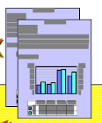

The Vision
Metadata Warehouse
Content Creation
Content Capture
& Programmatic
Extraction
Content Processed
Without Review
Selective Metadata
Attributes
Content Processed
& Reviewed By
Human
Content Creation
Concept Validation
Against CDS & Thesaurus
Concept Extration, Summarization
& Categorization Engine

Slide 56
What are we looking for?
Persistent metadata
  tools process single objects once
  invest once, use multiple times
  low risk because it feeds into a modular search architecture
  can introduce new smarter components as technology advances
  supports repurposing, republishing, syndication of content in a portal environment
  Not a single, hard coded structure
Metadata in multiple languages to support multilingual access & information management

Slide 57
In conclusion
I apologize if this presentation seems to be a little bit of everything
The problem is that taxonomies are critical components of any and all information systems, whether it is an integrated library system, a portal or a content management system
I hope there has been some value for you in this presentation – please feel free to use or repurpose any part of it that makes your work easier!

Slide 59
Collaboration: Maturity Model
ICAN | IDID | IKNOW
Ability to contribute ideas Ability to nurture ideation Ability to openly collaborate | Ability to get ideas through executed Ability to manage ideas throughout their entire lifecycle Ability to capture knowledge across the innovation pipeline | Ability to stay informed about what’s important Ability to accelerate decision making Ability to easily find information and knowledge about the life of an idea

Slide 60
Collaboration Roadmap
To:
Wisdom from the crowds
Collaborative company
Thought leader in pharma innovation
Agile Decision-Making
2008 (ICREATE)
2009 (ISHARE)
2010 (ICOLLABORATE)
Internal Ideation
&
Communities of Practice
External Ideation
&
Extend Social Networking to Customers & Partners
Open Collaboration
Optimized Ideation
Ideation
Integration of unmet customer needs with ideation lifecycle
Collaborative Company
Extending collaboration into Concept Development
&
Business Case Development
Accelerate
Decision-Making
Integrated Knowledge & Content Management
Idea Submission
&
Ideation Lifecycle Management
Create a COE for Analytics & Data Mining
Extending collaboration into Portfolio Mgmt
Build a Federated Data Warehouse
Transition
Implement an Enterprise Search Engine
Integrate
Data & Document Management
Start Defining & Building the “Glue”
(Metadata)
Define architecture roadmap for a
BI Framework
From:
Wisdom from a few
Pockets of collaboration
Silos of information & knowledge
Slow decision-making
Not among Top 25 most innovative companies
Execution
Information

Slide 61
Collaboration: End State Vision
The End State is achieved when:
  Anyone can share knowledge (ideas or information),
  Ideas from anyone can get executed in the innovation pipeline
  Knowledge & data is captured and integrated into the pipeline
  The Right information, is delivered to the Right people, at the Right Time in the Right manner

